Slide 1
Implementation and best practices for monitoring services towards certification El Salvador
MINISTRY OF HEALTH
ITS/VIH PROGRAM UNIT
CLINICAL LABORATORY OFFICE
AUGUST 2024

Slide 2
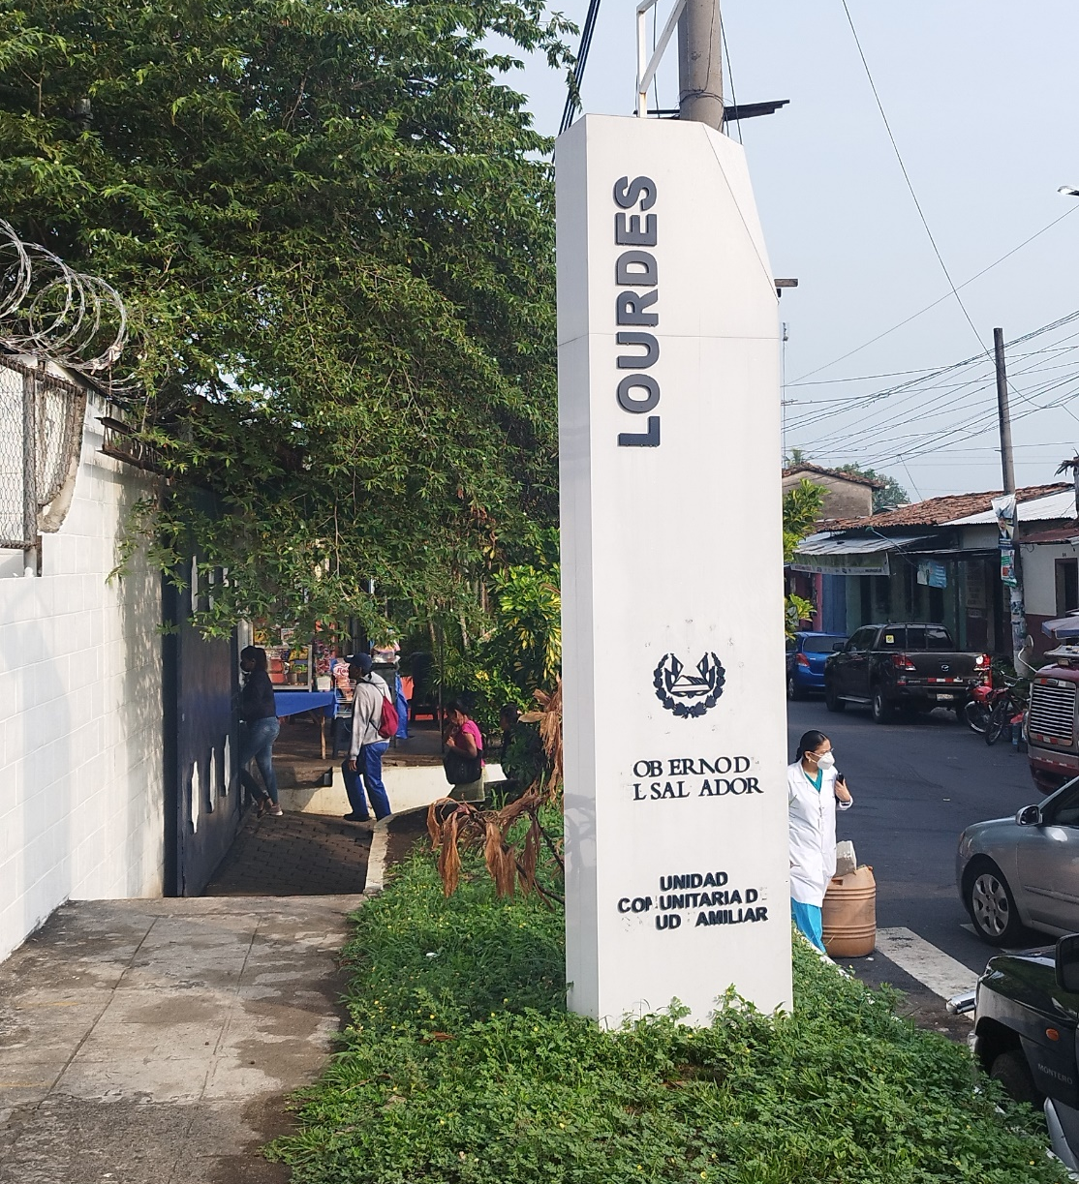
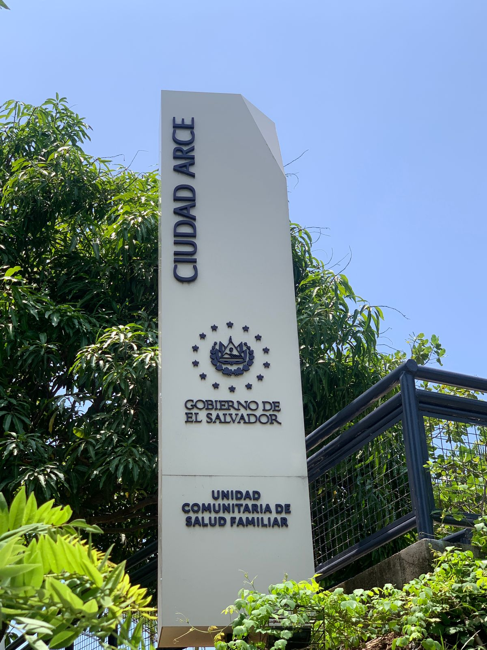
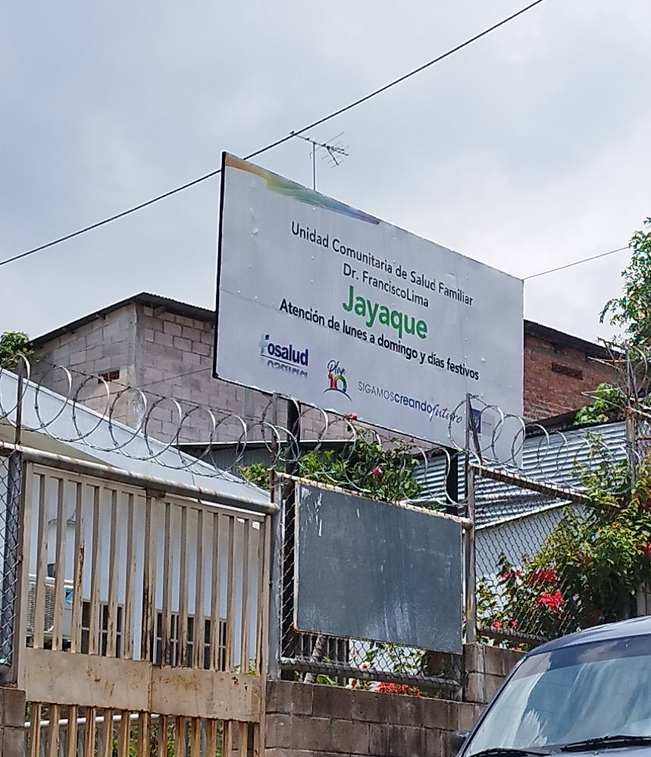
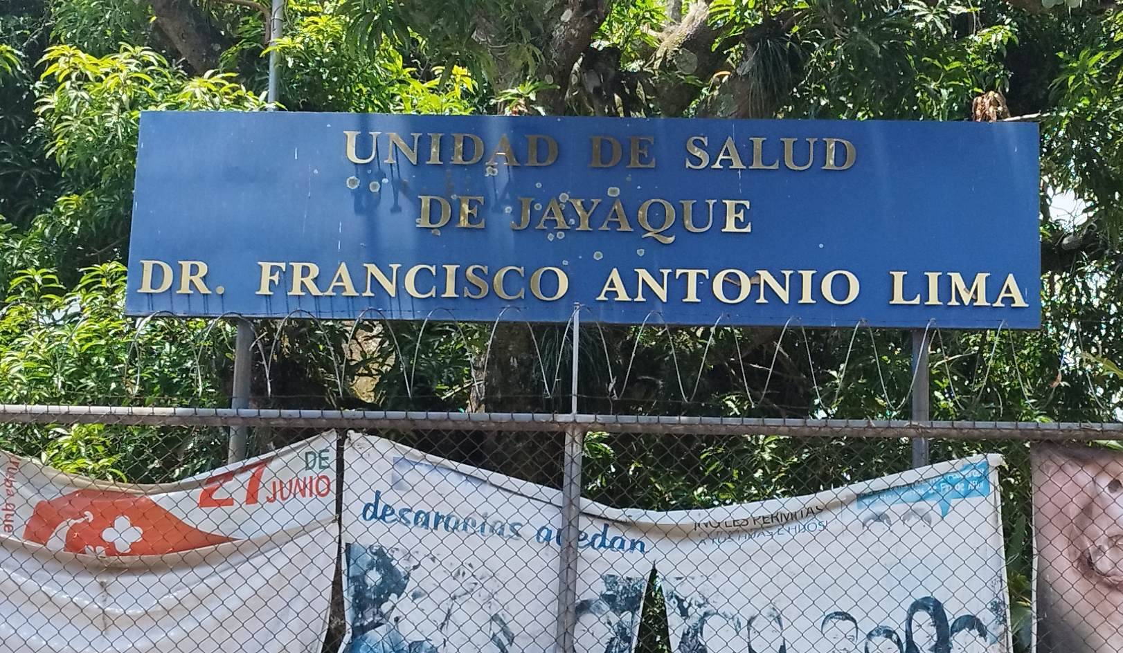

VISITS TO THE RTCQII EL SALVADOR SITES
SPI-RT development list
Management presentation
Measurement of competencies
Notification to the site
RTCQII VISITS
Staff retraining
Logistics
Improvement Plan

Slide 3

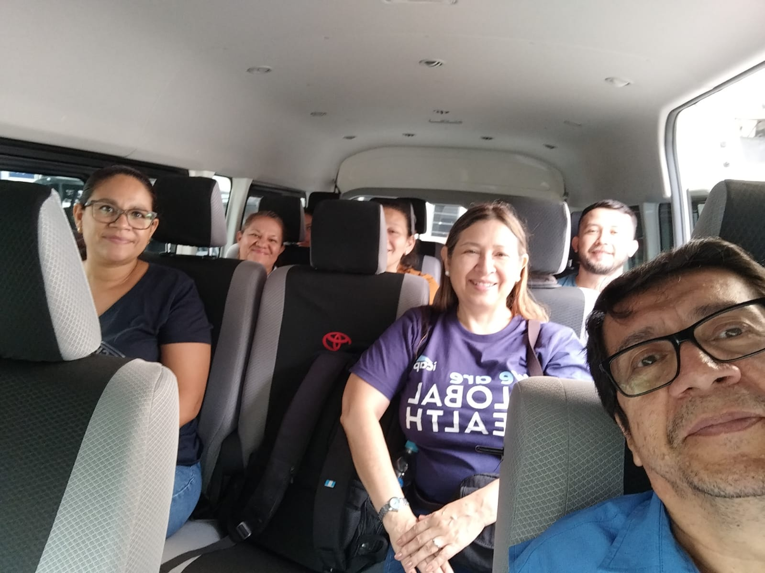
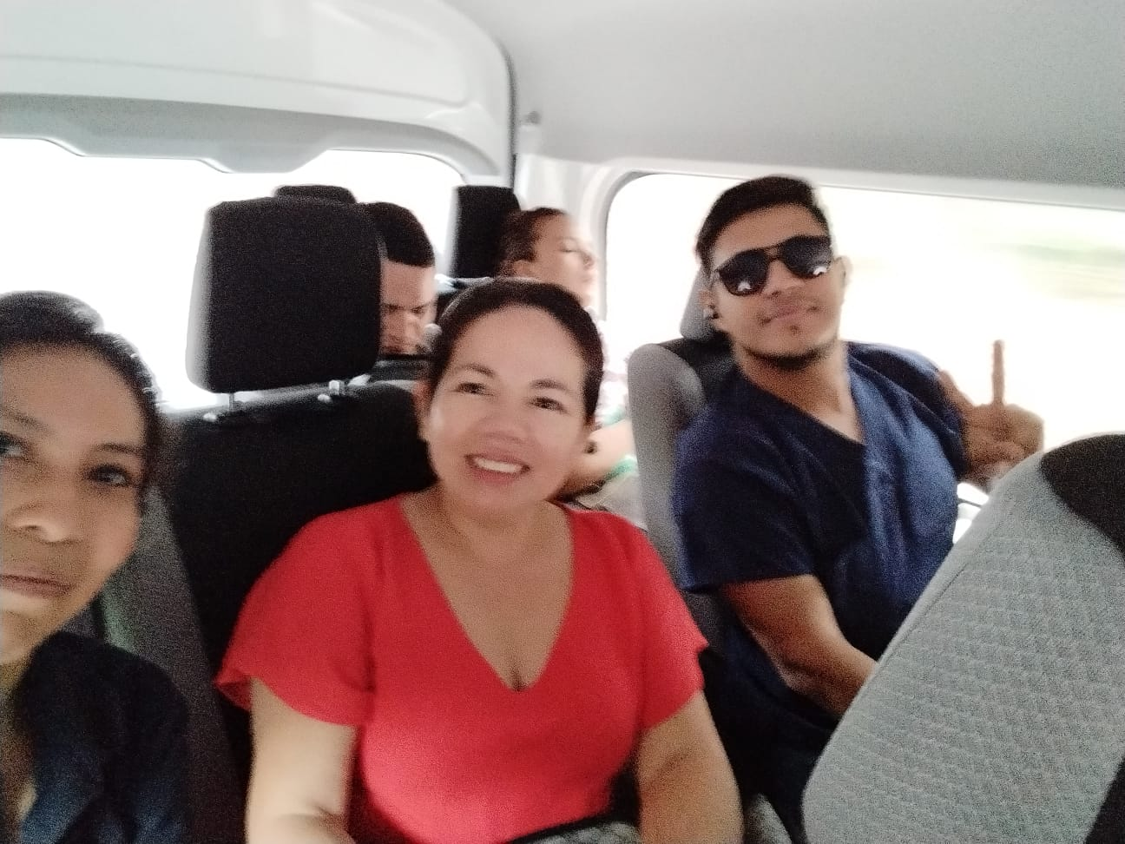
VISITS TO THE RTCQII EL SALVADOR SITES
Logistics
Development with implementing partners to define timing and logistical details
DATES
LOCATION
PARTICIPANTS
LIST OF NEEDS
TRANSPORTATION

Slide 4
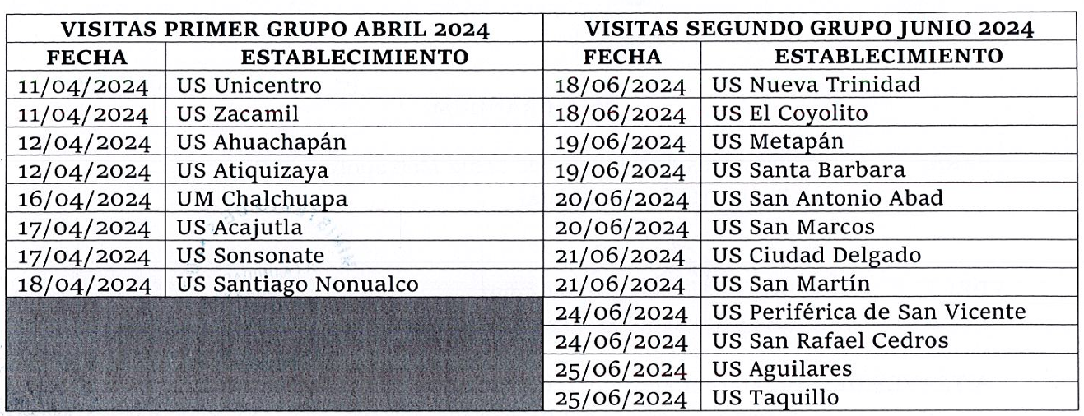
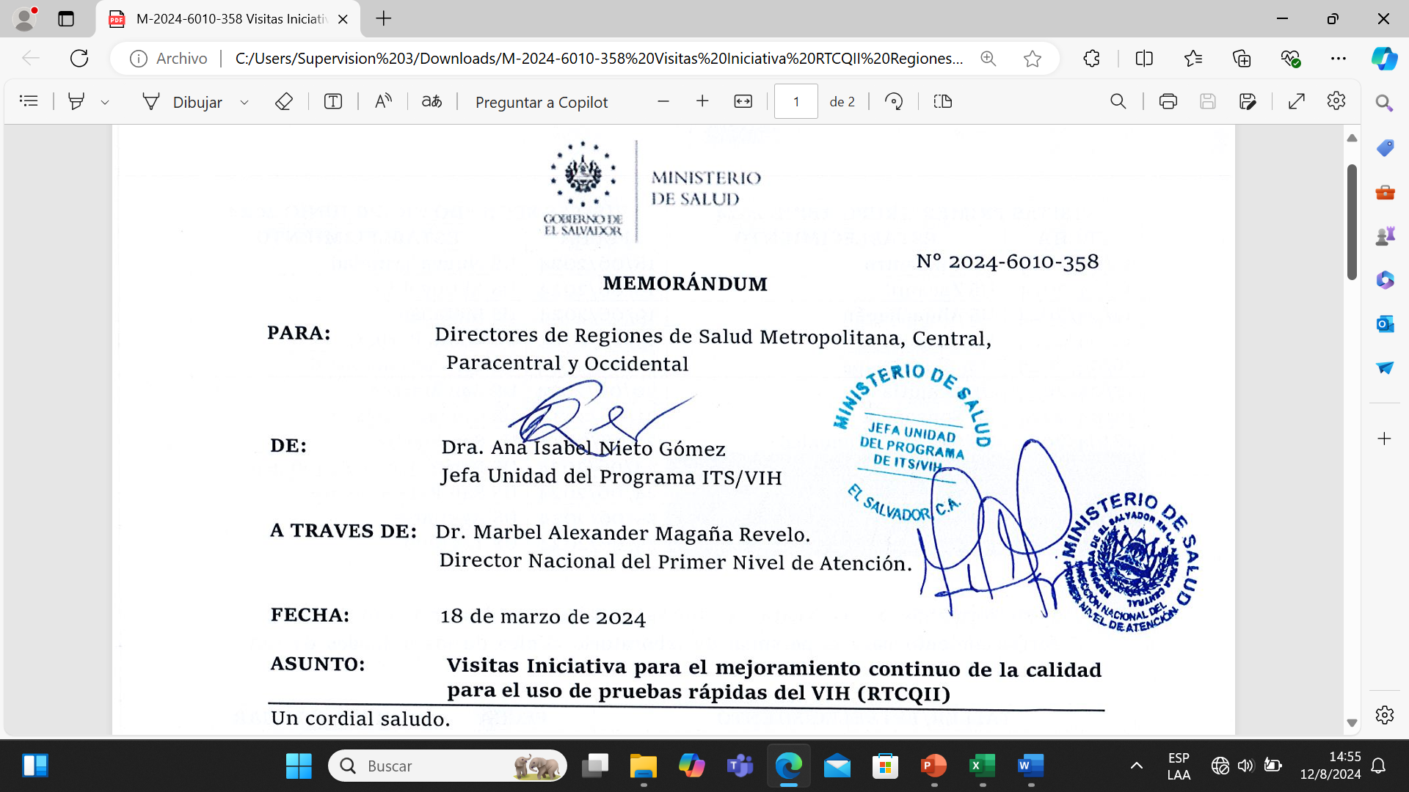
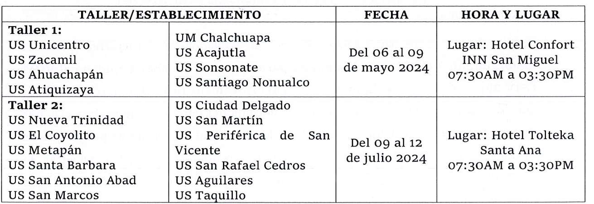
VISITS TO THE RTCQII EL SALVADOR SITES
Notification to the site
Designated sites and dates
Oficial letter MOH

Slide 5



VISITS TO THE RTCQII EL SALVADOR SITES
HIV Enhancement Initiative
Describes the RTCQII process
Management presentation
SPI-RT List
Methodology to be used
RTCQII Workshop
Next steps

Slide 6


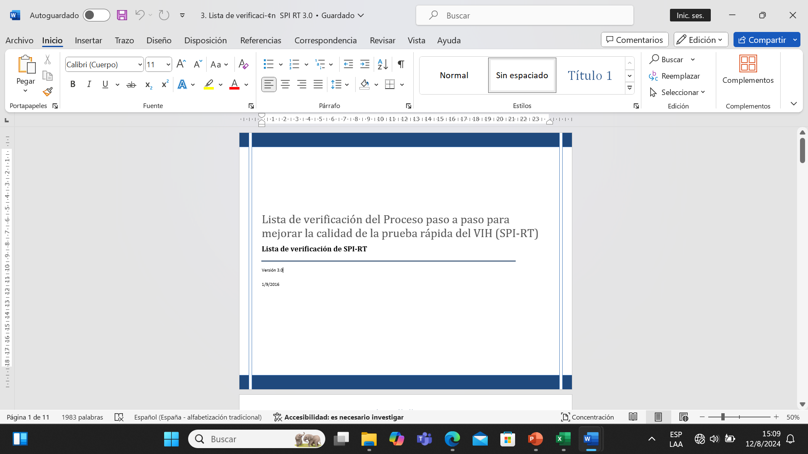
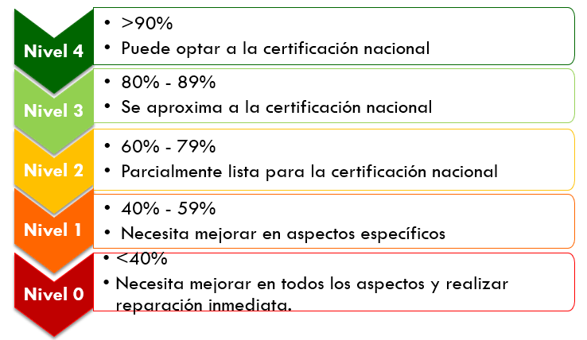
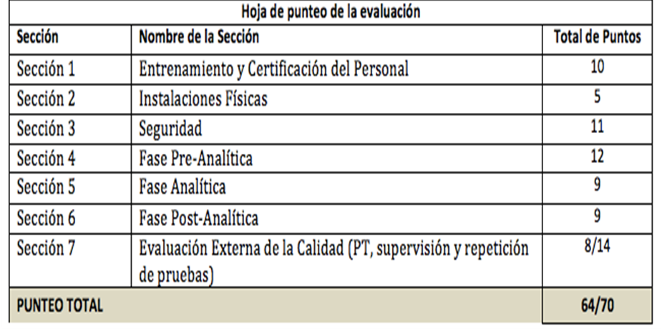
VISITS TO THE RTCQII EL SALVADOR SITES
SPI-RT development list
SPI-RT LIST
SCORECARD USED

Slide 7
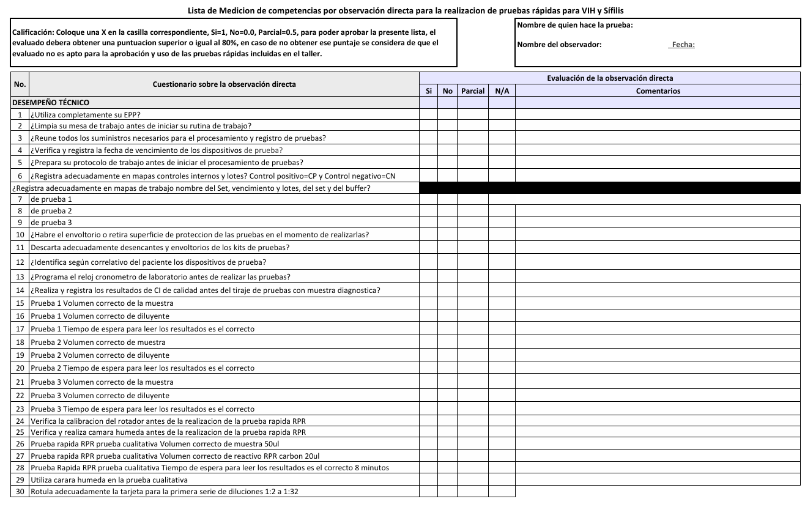
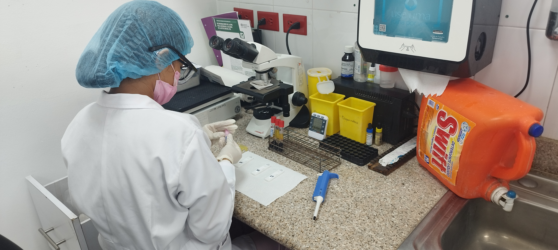
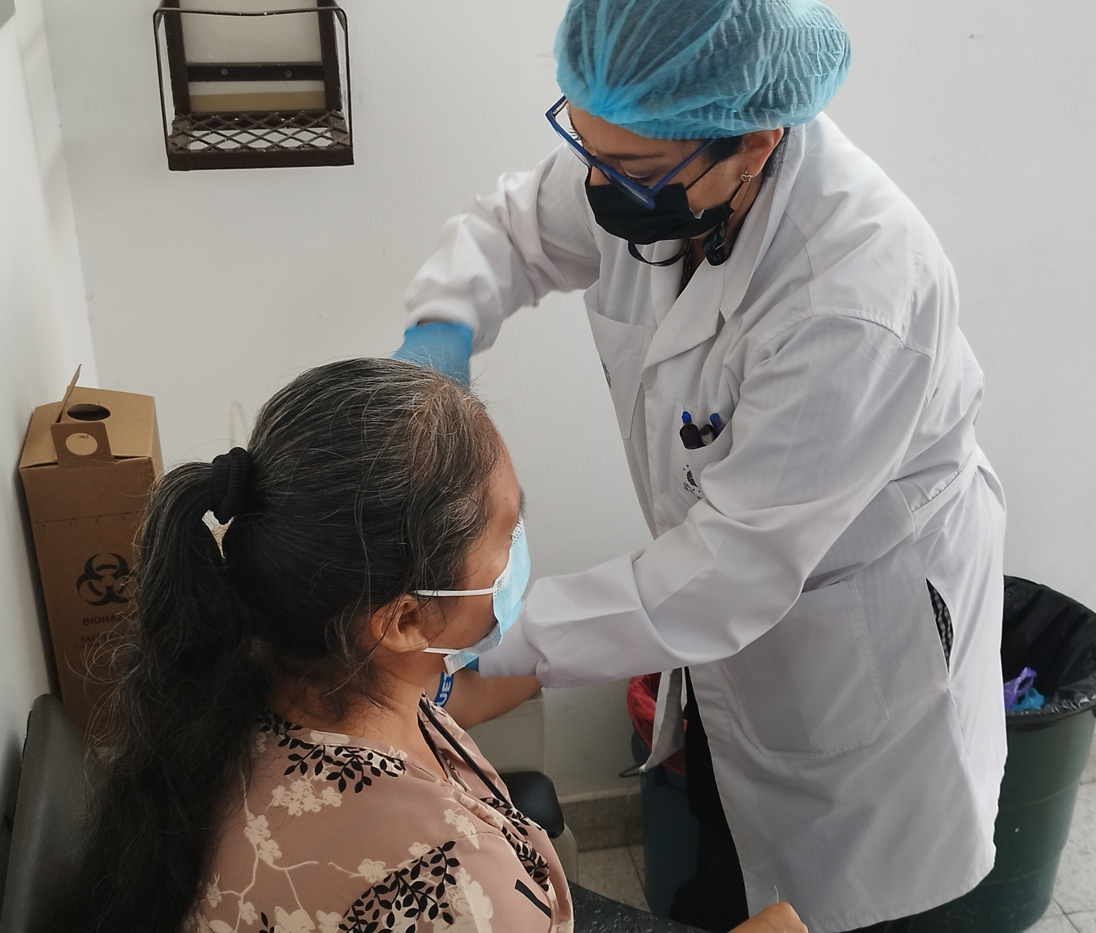
VISITS TO THE RTCQII EL SALVADOR SITES
Measurement of competencies

Slide 8
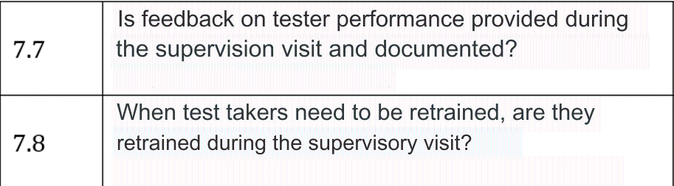

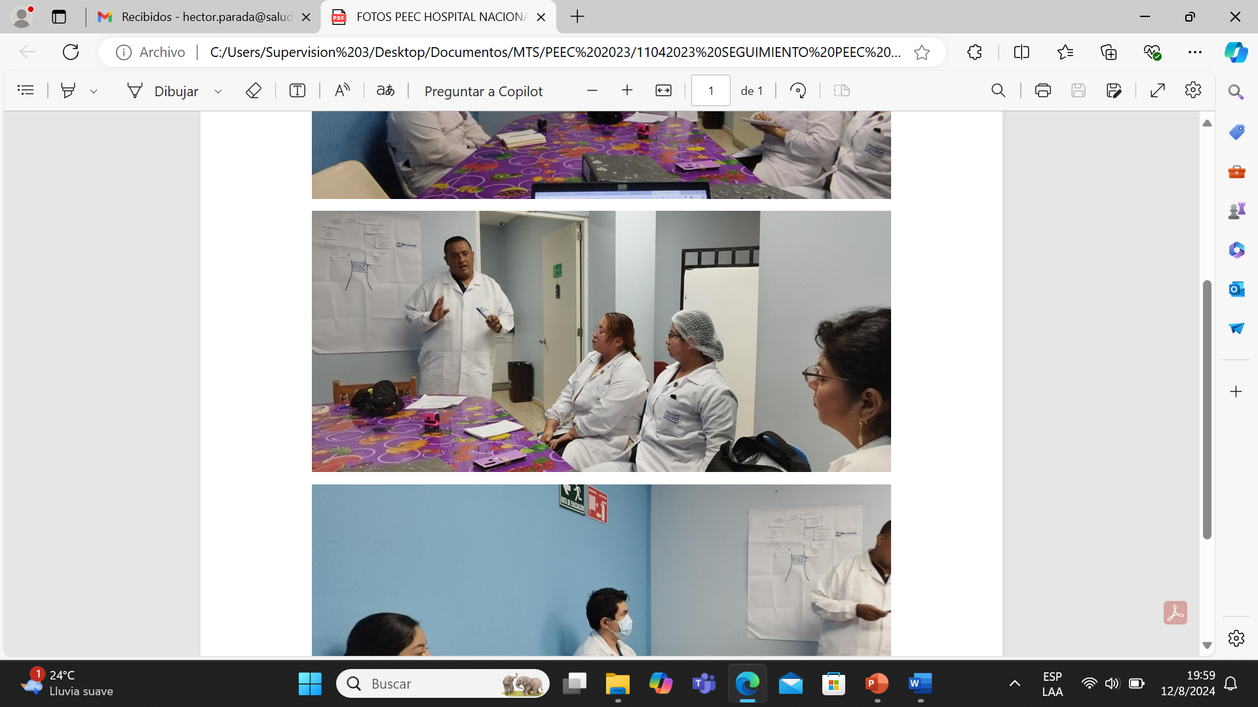
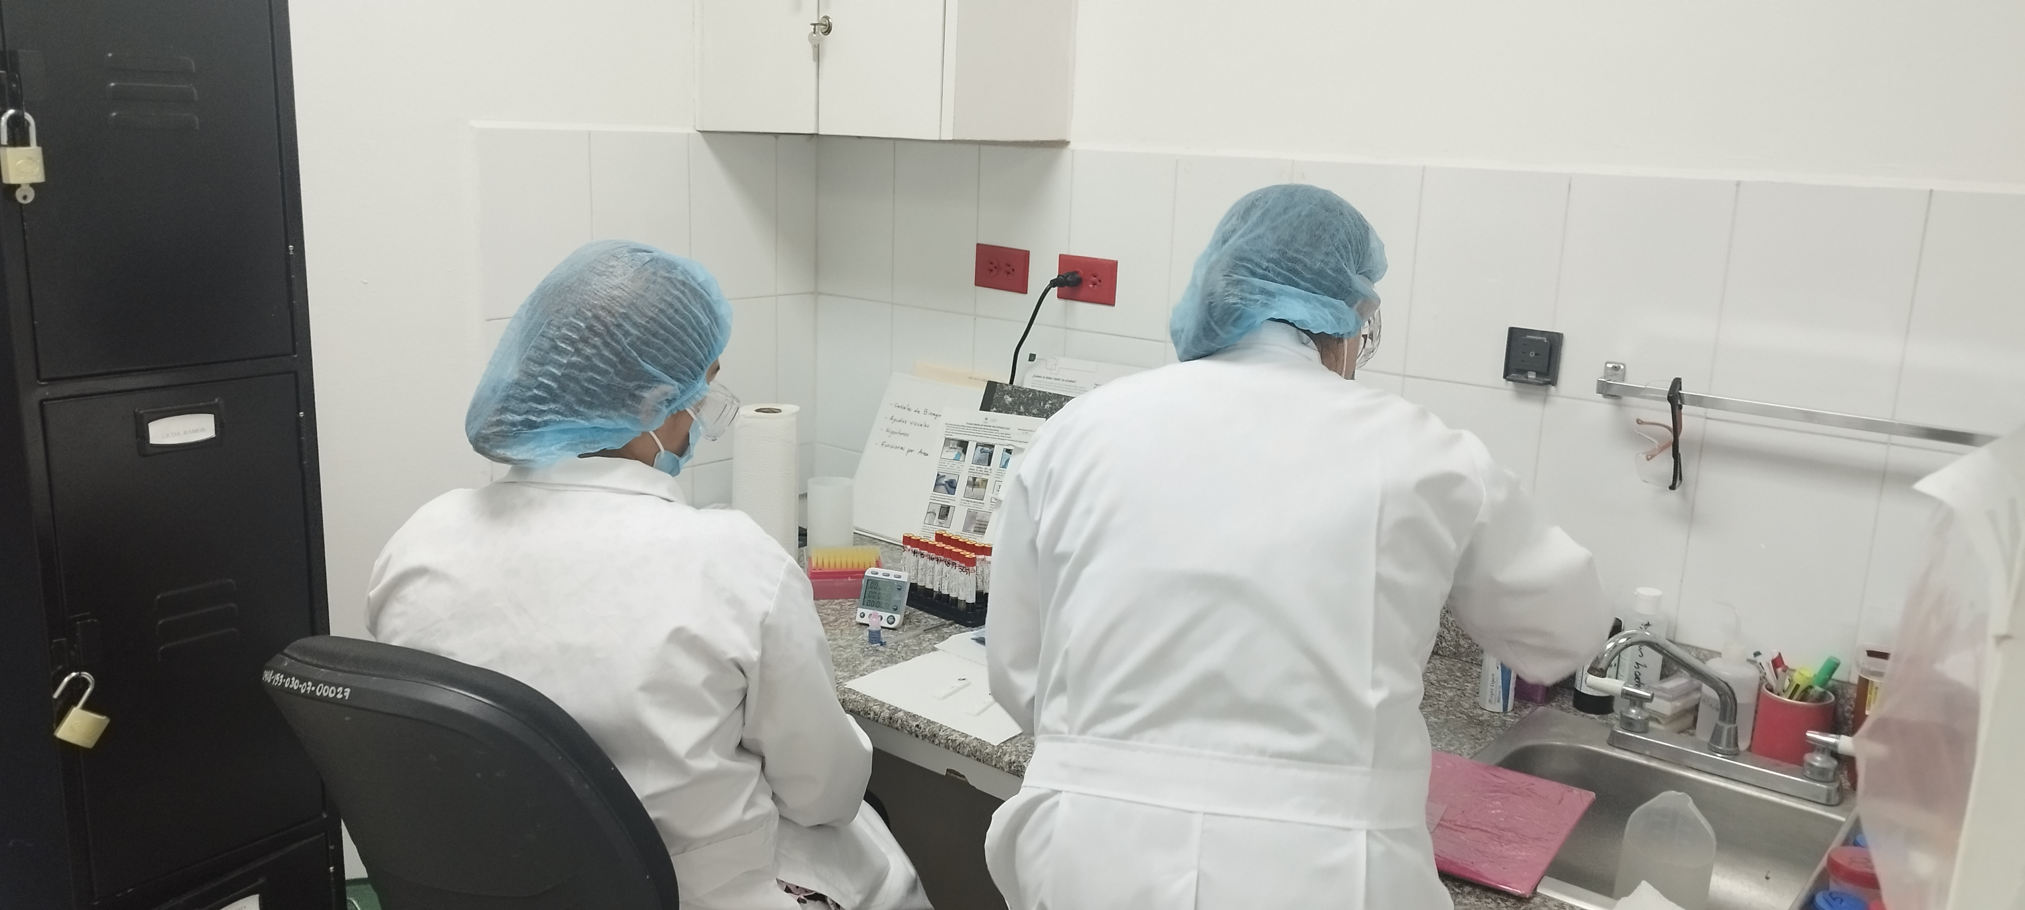
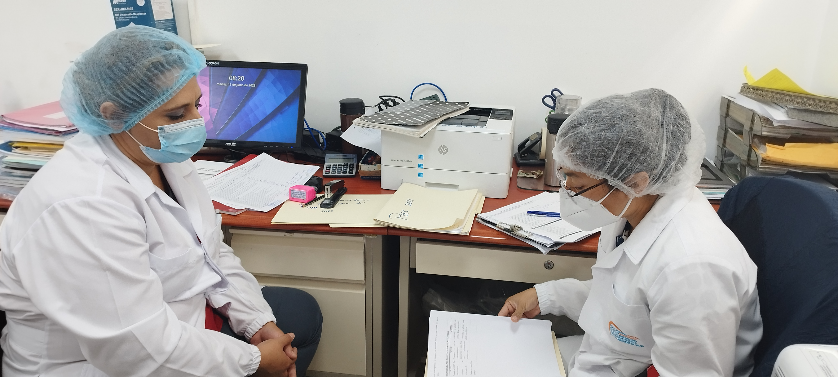
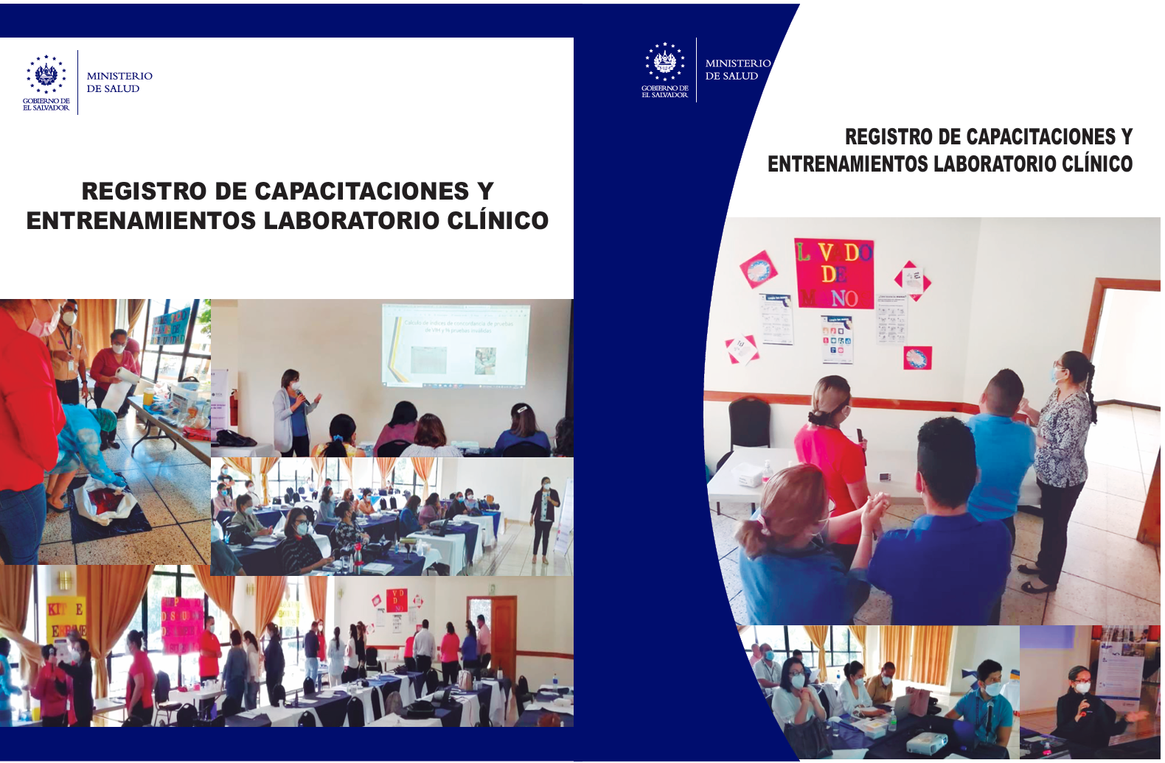
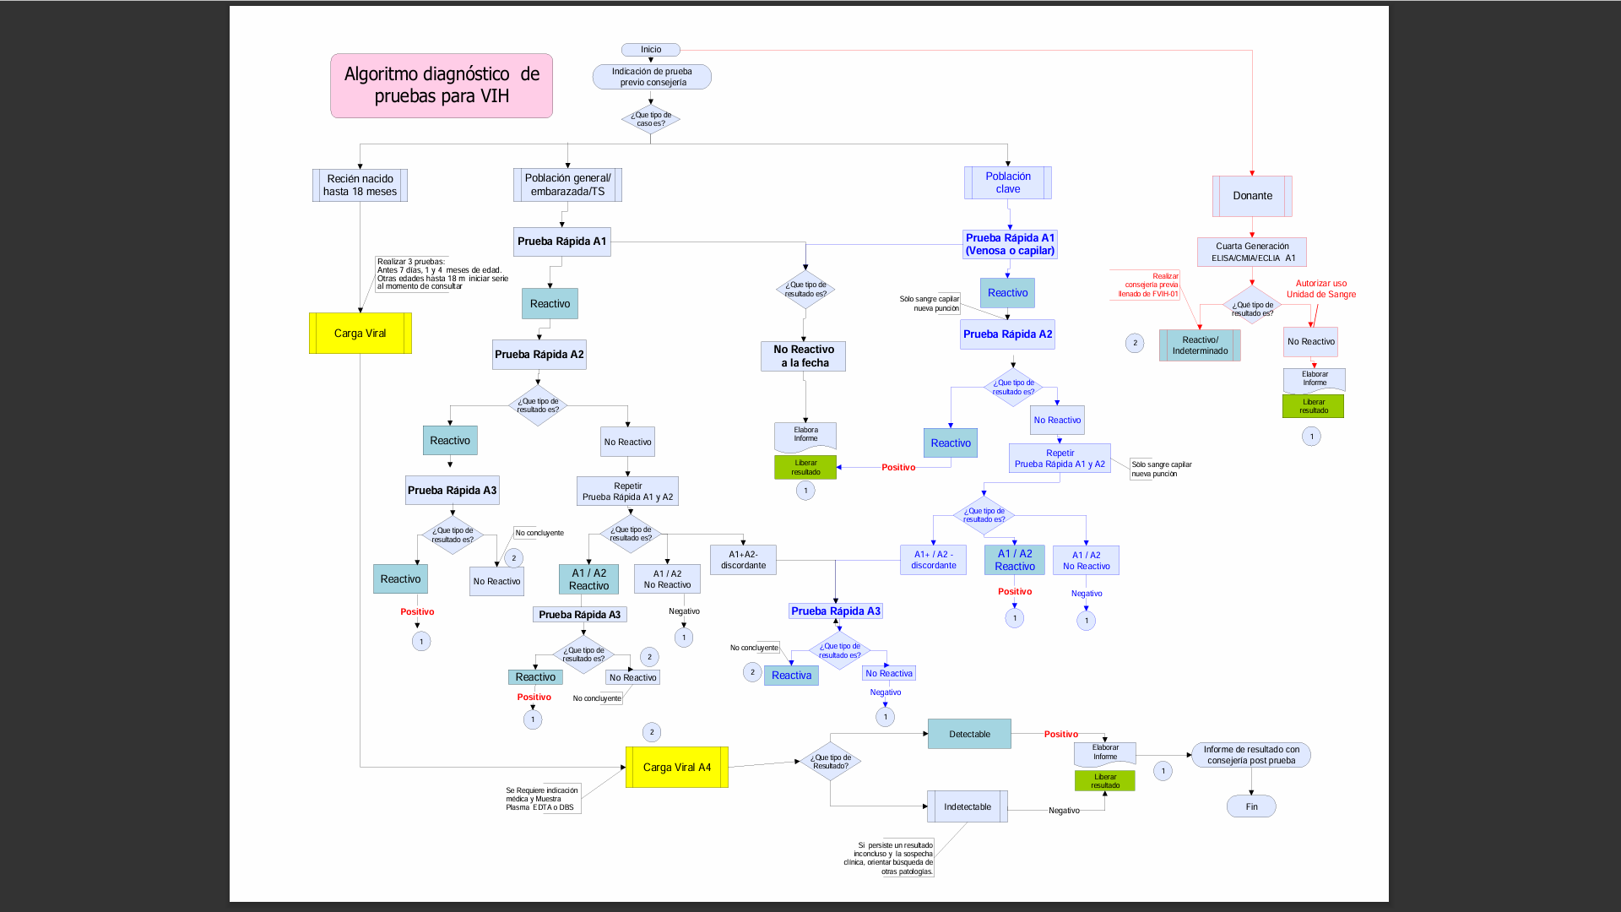
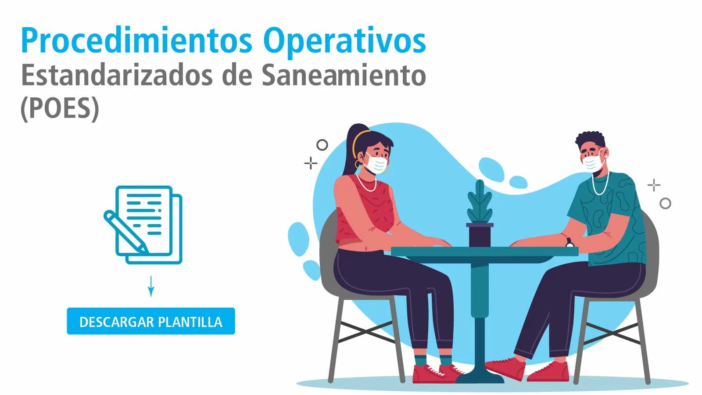

VISITS TO THE RTCQII EL SALVADOR SITES
Staff retraining

Slide 9
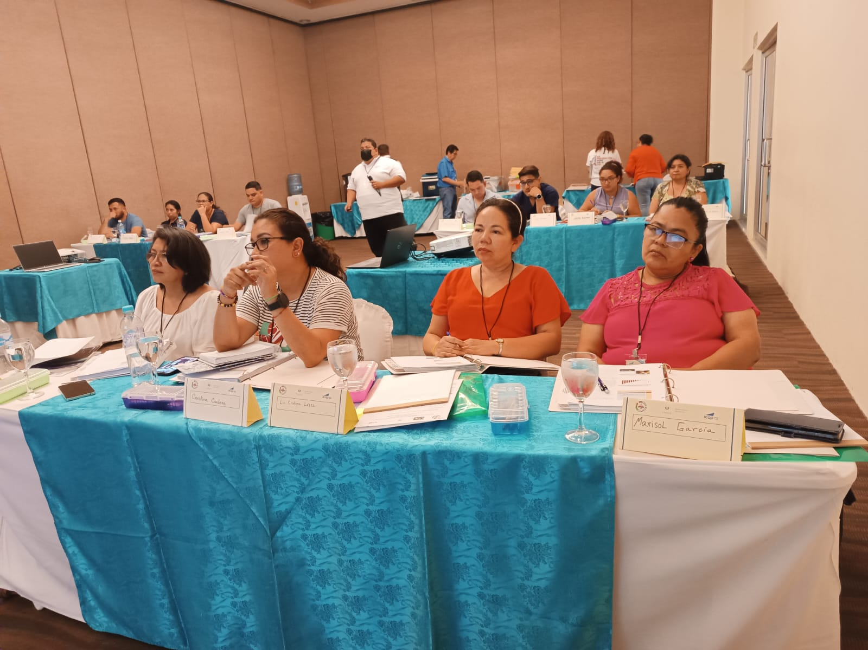
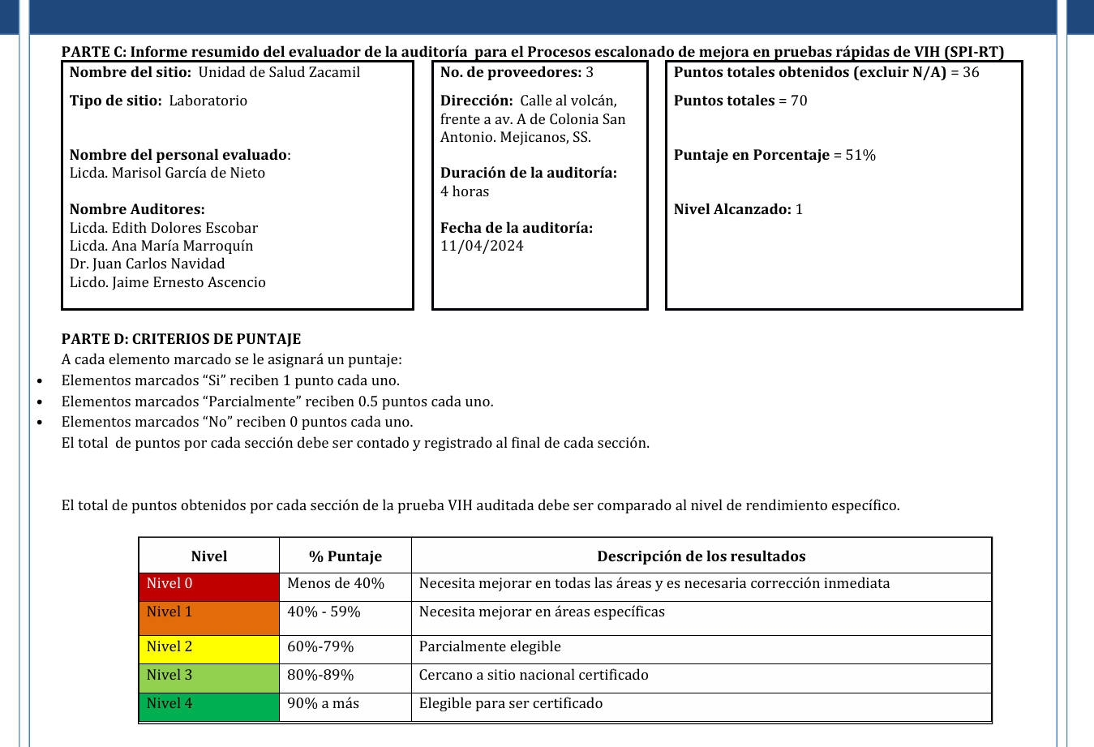
VISITS TO THE RTCQII EL SALVADOR SITES
Improvement Plan
Review, queries and doubts are addressed during the development of the RTCQII workshop.

Slide 10
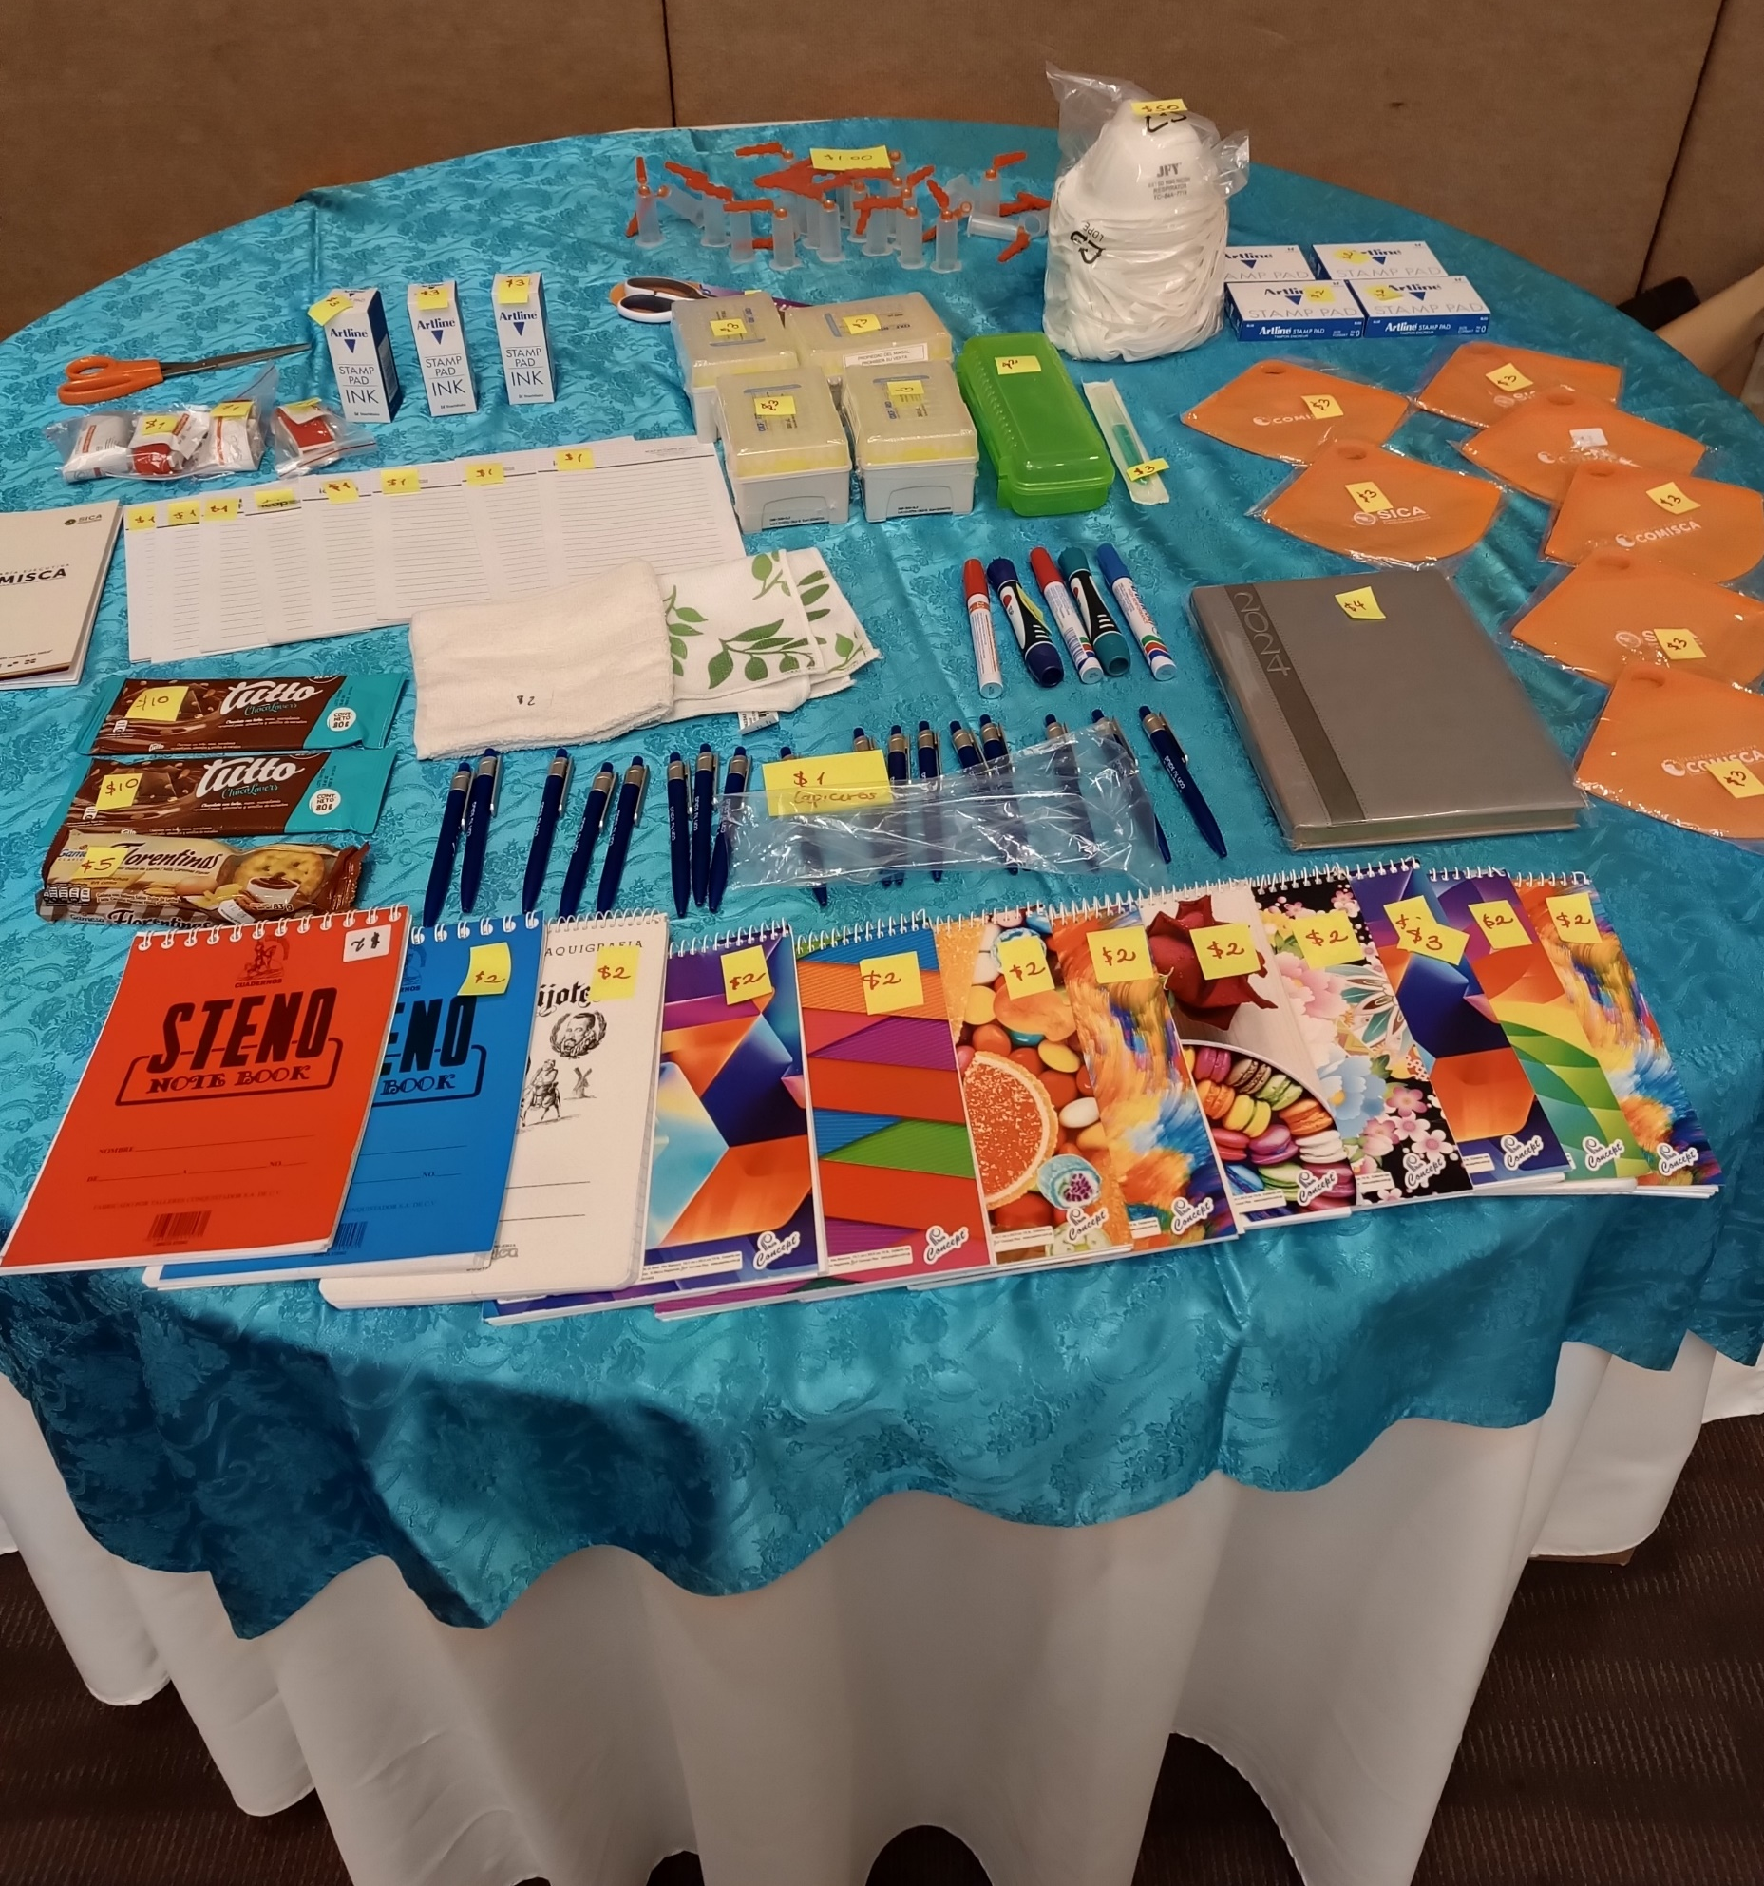
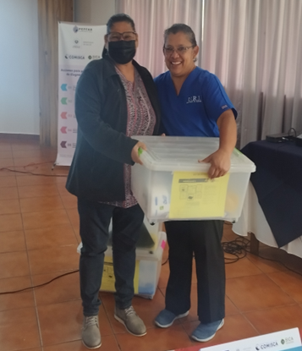


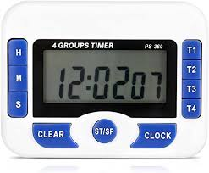

VISITS TO THE RTCQII EL SALVADOR SITES

Slide 11
Lessons learned in the proccess
1
Processes are carried out, but there is no habits for registration
3
Fear limits capacity to reason/ we have to work with the staff so that they understand the importance of supervising and see it as an improvement opportunity
2
There is work to do to help professional staff understand about SOP importance

